Slide 1
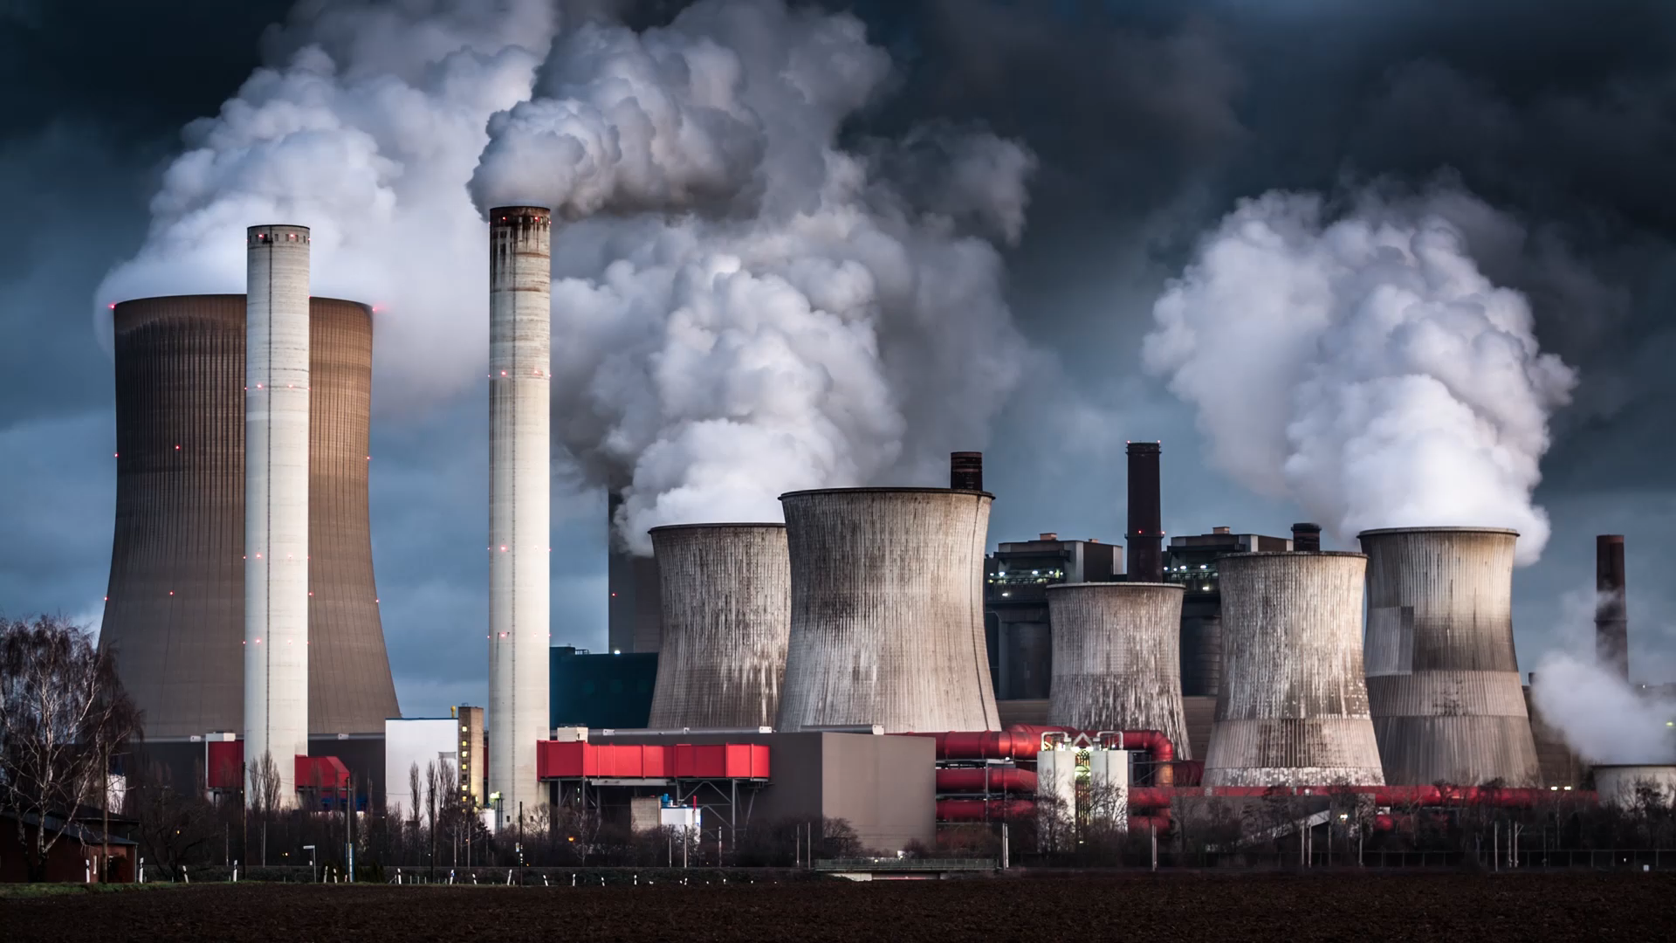
Green Skills Air Pollution
Made by Divjot Singh Riyat
IX-B

Slide 2
INDEX
What is air pollution?
What are the main contributors?
How to stop air pollution?

Slide 3
What is air pollution?
Air pollution is the contamination of air due to the presence of substances in the atmosphere that are harmful to the health of humans and other living beings, or cause damage to the climate or to materials.

